Slide 1
Chapter 1
Introduction to Financial Management
Finance 6th Edition
Cornett, Adair, and Nofsinger
© McGraw Hill LLC. All rights reserved. No reproduction or distribution without the prior written consent of McGraw Hill LLC.

Slide 2
Learning Goals
Define the major areas of finance as they apply to corporate financial management.
Show how finance is at the heart of sound business decisions.
Learn the financial principles that govern your personal decisions.
Examine the three most common forms of business organization in the United States today.
Distinguish among appropriate and inappropriate goals for financial managers.
Identify a firm’s primary agency relationship and discuss the possible conflicts that may arise.
Discuss how ethical decision making is part of the study of financial management.
Describe the complex, necessary relationships among firms, financial institutions, and financial markets.
Understand how the new tax law impacts financial decision making.

Slide 3
Introduction
Finance is the study of applying specific value to things we own, services we use, and decisions we make.
Financial management concentrates on valuing things from the perspective of a company or firm.
Variables that have significant impact on the firm’s financial decisions.
Organizational form of the business.
Agency relationship between managers and owners.
Ethical considerations.

Slide 4
Finance in Business and in Life
Cash flow is the term that describes the process of paying and receiving money.
Money flows from individuals who want to improve their financial future to businesses that want to expand the scale or scope of their operations.
These financial exchanges lead to.
A more productive economy.
The growth of individuals’ wealth.

Slide 5
Economic Participants
Group all of an economy’s participants along two dimensions.
First dimension is made up of those who may have “extra” money for investment.
Second dimension is made up of those who have an ability to develop viable business ideas, a sense of business creativity.
 | No Extra Money | Extra Money
No Economically Viable Business Ideas | Type 1: No money and no ideas | Type 2: Money but no ideas
Economically Viable Business Ideas | Type 3: No money but ideas | Type 4: Both money and ideas

Slide 6
Economic Participants – Type 1
Type 1 participants.
Do not lend significant sums of money (capital) or spend much money in business context.
No direct role in financial markets.
Play an indirect role by providing labor to economic enterprises or by consuming their products.

Slide 7
Economic Participants – Type 4
Type 4 participants.
Use financial tools to evaluate their own business concepts and then choose the ideas with the most potential.
Self-funded, so they have no need for financial markets.
Financial tools used and types of decisions made are narrowly focused to their own purposes.

Slide 8
Economic Participants – Types 2 and 3
Types 2 and 3 participants.
Financial markets and financial institutions allow these people to participate in a mutually advantageous exchange.
Type 2 participants, who are usually individual investors, make temporary loans to type 3 participants, who put that money to use with their good business ideas.
Type 3 participants are idea generators, typically companies with research and development (R&D) departments.

Slide 9
Where Does the Cash Go?
Investors lend “extra” capital to companies, who use the capital to fund expansion projects.
Successful projects will eventually be able to repay the money (plus profit) to investors.
Sources of friction arise, as not all cash is returned to investors.
Retained earnings are funds the firm keeps for its ongoing operations.
Taxes are imposed on corporations and individuals by the government to help fund public services.

Slide 10
Subareas of Finance 1
Investments is the subarea of finance that involves methods and techniques for making decisions about the following:
What kinds of securities to own (e.g., bonds or stocks).
Which firms’ securities to buy.
How to pay the investor back in the form that the investor wishes (e.g., the timing and certainty of the promised cash flows).

Slide 11
Subareas of Finance 2
Financial management is the subarea of finance that deals with a firm’s decisions in acquiring and using the cash that is received from investors or from retained earnings.
Involves decisions about the following:
How to organize the firm in a manner that will attract capital.
How to raise capital (e.g., bonds versus stocks).
Which projects to fund.
How much capital to retain for ongoing operations and new projects.
How to minimize taxation.
How to pay back capital providers.

Slide 12
Subareas of Finance (Concluded)
Financial institutions and markets are organizations that facilitate the flow of capital between investors and companies.
International finance is the use of finance theory in a global business environment.
Decisions are complicated by the uncertainty about future exchange rates, political risk, and changing business laws across the globe.

Slide 13
Application and Theory 1
Future cash flows are uncertain in terms of both timing and size.
Risk is a potential negative impact to value and/or cash flows.
Comparing rewards with risks often involves assessing the value today of cash flows that are expected to be received in the future.
Price of a financial asset (i.e., something worth money, such as a stock or bond) should depend on the cash flows you expect to receive from that asset in the future.

Slide 14
Application and Theory 2
Firms are more likely to find “bargain” projects than investors are to find underpriced stocks.
Business projects involve real assets trading in real markets.
Real assets are physical property like gold, machinery, equipment, or real estate.
Real markets are places/processes that facilitate the trading of real assets.
Time value of money (T V M) involves valuing cash flows at various points in time
Notes:
In the real environment, some level of monopoly power, special knowledge, and expertise possibly can make such projects worth more than they cost. Investors, however, are trading financial assets in financial markets, where the assets are more likely to be worth, on average, exactly what they cost.

Slide 15
Finance vs. Accounting
Financial function is usually closely associated with the accounting function.
Accountant’s job is to keep track of what happened in the past to the firm’s money.
Finance job uses historical figures with current information to determine what should happen now and in the future with the firm’s money.

Slide 16
The Financial Manager
Chief financial officer, or C F O, is usually the firm’s highest–level financial manager.
Controller and treasurer report to C F O.
Controller oversees accounting function.
Treasurer is usually responsible for these tasks:
Managing cash and credit.
Issuing and repurchasing financial securities.
Deciding how and when to spend capital for new and existing projects.
Hedging against changes in F X and interest rates.

Slide 17
Finance in Other Business Functions
Finance permeates the entire organization.
Operational managers.
Determine how much overtime labor to use.
Perform cost/benefit analysis when they consider new production lines or methods.
Marketing managers.
Assess cost–effectiveness of follow–up marketing surveys.
Human resource managers.
Evaluate cost for various employee benefit packages.

Slide 18
Finance in your Personal Life
Finance can help with personal financial decisions.
Borrowing money to buy a new car.
Refinancing home mortgage at lower rate.
Making credit card or student loan payments.
Saving for retirement.
Recent changes make financial knowledge even more valuable.
Most companies have switched from providing employees defined benefit plans to offering defined contribution plans (such as 401k plans) and self–funded plans like Individual Retirement Accounts (I R As).

Slide 19
Business Organization
Number of owners is the key to how business structures are classified.
Single owners, partners, and corporations operate businesses.
Advantages and disadvantages related to the following:
Control and ownership of firm.
Owners’ risks.
Access to capital and tax ramifications.

Slide 20
Characteristics of Business Organizations
 | Ownership | Control | Ownership Risk | Access to Capital | Taxes
Sole Proprietor | Single individual | Proprietor | Unlimited liability | Very limited | Paid by owner
Partnership | Multiple people | Shared by partners | Unlimited liability | Limited | Paid by partners
Corporation | Public investors who own the stock | Company managers | Stockholders can only lose their investment in the firm | Easy access | Corporation pays income tax and stockholders pay taxes on dividends
Hybrids: S corp, L L P, L L C, L P | Partners or shareholders | Shared | Mostly limited | Limited by firm size restrictions | Paid by partners or shareholders

Slide 21
Sole Proprietorships
Sole proprietorship is any unincorporated business owned by a single individual.
Most common type of business in the U.S.
Advantages include being easy to start, being subject to a relatively lighter regulatory and paperwork burden, and owner having complete control of the firm’s activities.
Disadvantages include unlimited liability for company’s debts and actions and difficulty in raising capital.

Slide 22
General Partnerships
General partnership is an organizational form that features multiple individual owners.
Each partner can own different percentage of firm.
Profits are split among partners according to prearranged agreement.
Partners jointly share unlimited personal liability for debts of the firm.
Easier to raise capital than sole proprietorships.
To raise enough capital for substantial growth, partnerships often change into public corporations.

Slide 23
Public Corporations
Public corporation is a legally independent entity entirely separate from its owners.
Hold many rights and obligations of individual persons (e.g., ability to own property, sign binding contracts, and pay taxes).
Shareholders are subject to double taxation.
Managers control the company, as corporations typically have thousands of stockholders.
Shareholders have limited liability.
Relatively simple to raise capital.

Slide 24
Hybrid Organizations
Hybrid organizations offer single taxation and limited liability to all owners.
S corporations.
Limited liability partnerships (L L Ps).
Limited liability companies (L L Cs).
Limited partnerships (L Ps).
To promote the growth of small business, the U.S. government usually restricts hybrid organization status to relatively small firms.
Notes:
LPs offer single taxation and limited liability to the limited partners, but also have general partners, who benefit from single taxation but also must bear personal liability for the firm’s debts.

Slide 25
Firm Goals
What should corporate goals be?
Owners’ perspective says the appropriate goal is to maximize shareholder wealth (i.e., maximizing the current value per share, or stock price, of existing shares).
Stakeholders’ perspective emphasizes social responsibility over profitability.
Maintains that managers must maximize the total satisfaction of all stakeholders in a business, including the owners and shareholders, but also including the business’s customers, employees, and local communities.
Notes:
Financial practitioners and academics now tend to believe that the manager’s primary responsibility should be to maximize shareholder wealth and give only secondary consideration to other stakeholders’ welfare.

Slide 26
Agency Problem 1
Stockholders hire managers to run the company, but managers may be tempted to act in their own best interests.
Agency problem refers to the difficulties that arise when a principal (shareholder) hires an agent (manager) and cannot carefully monitor the agent’s actions.
Manager’s interest may not be aligned with shareholder goals.

Slide 27
Agency Problem 2
Three approaches to minimizing this conflict of interest.
Ignore it.
Research suggests allowing the manager a certain amount of perks might enhance owner value because it may boost managers’ productivity.
Monitor managers’ actions.
Make the managers owners to align their personal interest with those of owners.
Offer managers an equity stake in the firm.

Slide 28
Corporate Governance
The process of monitoring managers and aligning their incentives with shareholder goals is known as corporate governance.
Corporate governance involves the set of laws, policies, incentives, and monitors designed to handle the issues arising from the separation of ownership and control.

Slide 29
Corporate Governance – Inside Monitors
Inside monitors.
Board of directors are elected by stockholders to oversee management in a corporation.
Activities involve the following:
Hiring the C E O.
Evaluating management.
Designing compensation contracts to tie management’s salaries to firm performance.

Slide 30
Corporate Governance – Outside Monitors
Outside monitors.
Auditors examine the firm’s accounting systems and comment on whether financial statements fairly represent the firm’s financial position.
Investment analysts follow a firm, conduct their own evaluations, and report to the investment community.
Investment banks help firms access capital markets.
Credit analysts examine a firm’s financial strength for its debt holders.
Government also monitors activities via S E C and I R S.

Slide 31
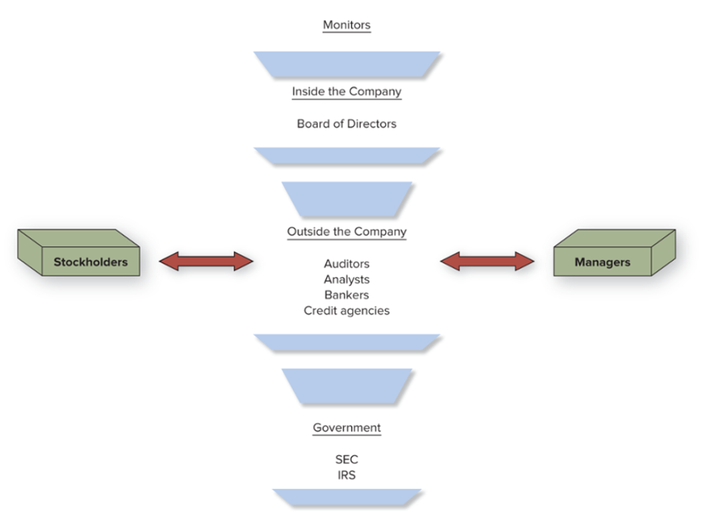
Corporate Governance Monitors
Access the text alternative for slide images.
Notes:
Corporate governance balances the needs of stockholders and managers. Inside the public firm, the members of the board of directors monitor how the firm is run. Outside the firm, auditors, analysts, investment banks, and credit rating agencies act as monitors.

Slide 32
The Role of Ethics
Financial professionals commonly manage other people’s money, creating a fiduciary relationship.
Corporate managers control the stockholder’s firm.
Bank employees manage deposits.
Investment advisors manage people’s portfolios.
Ethical dilemmas result from agency relationship between managers and stockholders.

Slide 33
Financial Markets and Intermediaries
If financial markets are competitive, how do investment banks and other financial institutions make such impressive profits?
Successful execution of services offered by these firms require unique expertise and assets.

Slide 34
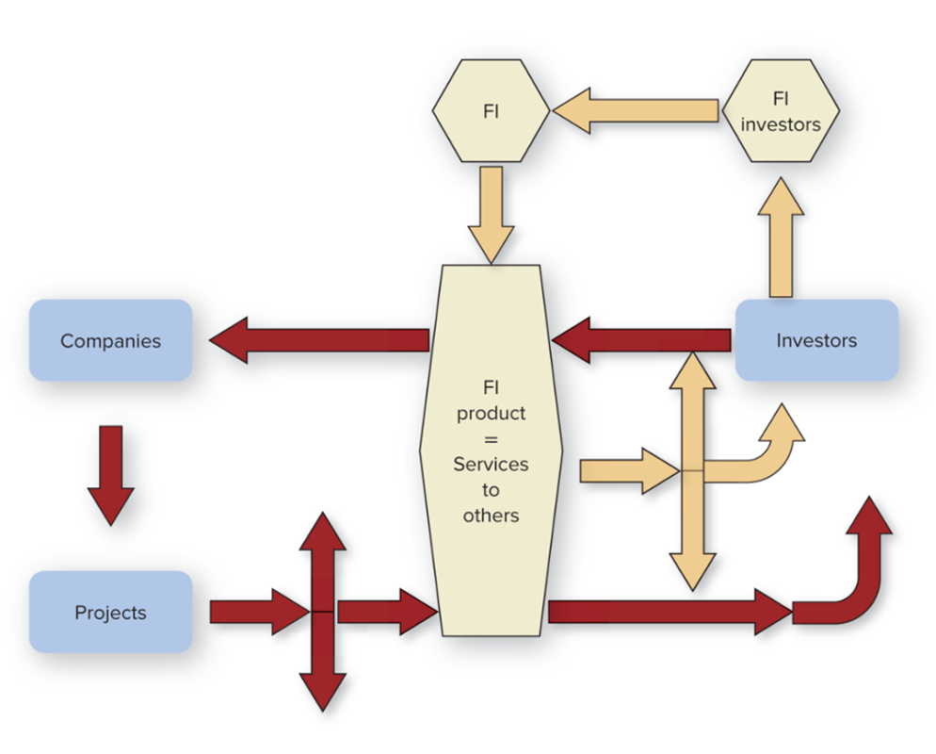
Financial Institutions’ Cash Flows
Access the text alternative for slide images.
Notes:
The unique services and products that financial institutions provide allow them to make money.

Slide 35
Big Picture Environment
Recent factors affecting the business environment in the U.S. are the following:
Tax Cuts and Jobs Act (T C J A) of 2017.
Net effect was to reduce effective tax rates for most individuals and corporations.
Supports argued corporate tax cuts would eventually “trickle down” to workers wages.
COVID–19 pandemic of 2020.
Economic effects are likely to greatly reduce the chances of the T C J A being extended past 2025.

Slide 36
Tax Cuts and Jobs Act (T C J A) of 2017
Reductions in individual income tax rates.
Corporate tax rates reduced.
New deduction for “pass–through” business income.
Liberalized asset expensing and depreciation provisions.
New limits on business interest deductions.
Stricter rules for deducting losses.
Reduced or eliminated deductions for business entertainment and some employee fringe benefits.
Change to R&D expense deduction.

Slide 37
End of Main Content
© McGraw Hill LLC. All rights reserved. No reproduction or distribution without the prior written consent of McGraw Hill LLC.

Slide 38
Accessibility Content: Text Alternatives for Images

Slide 39
Corporate Governance Monitors – Text Alternative
Return to parent-slide containing images.
The monitors inside the company are the Board of Directors; outside the company are auditors, analysts, bankers, credit agencies, as well as stockholders and managers, and government agencies including the S E C and the I R S.
Return to parent-slide containing images.

Slide 40
Financial Institutions’ Cash Flows – Text Alternative
Return to parent-slide containing images.
From investors, flow to F I investors, to F I, to F I product = Services to others. From F I product = Services to others to companies, then to projects and back to F I product = Services to others. From F I products back to investors.
Return to parent-slide containing images.

